Slide 1
Big Mountain Resort
Executive Presentation

Slide 2
Problem Identification
What can be done to cover the expenses of the new lift that was installed?
Is there room to increase the ticket price to cover the new expense?
Is the resort charging enough for what it provides?

Slide 3
Recommendation & Key Findings
The data used contains information on most ski resorts in the US.
Based on our findings we recommend increasing the ticket price by $5-10.
It was found that changes in snow making acreage has little to do with ticket price.
As for number of runs, it was found that removing 3-5 runs would warrant a $0.75 ticket price decrease. And removing 6-9 runs warrants a $2.25 decrease in ticket price.
Adding 150ft of vertical drop, a new run, and another chair lift would support a $1.99 increase in ticket price.

Slide 4
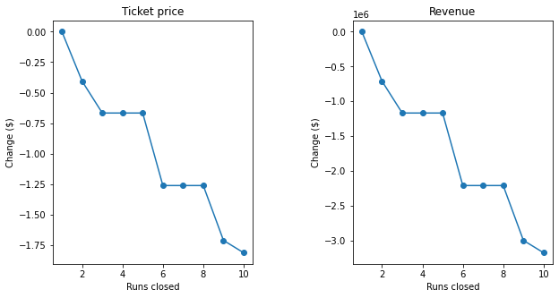
Modeling & Analysis
This graph represents the supported price decrease as it relates to removing runs.

Slide 5
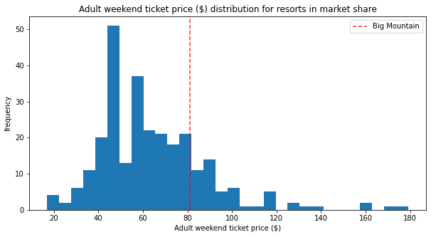
Modeling & Analysis
This histogram represents Big Mountain Resorts ticket price compared to all other ski resorts In Montana.
It is clear that while Big Mountain is near the higher end of the spectrum, there is still room to increase ticket price.

Slide 6
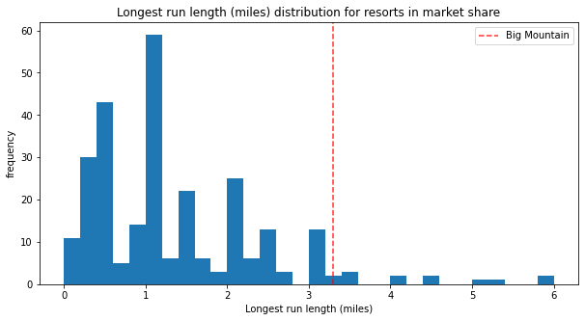
Modeling & Analysis
This graph represents the longest runs in the market share. Big Mountain Resort is among the ski resorts with the longest runs. According to predictions, making a longer run would not support an increase in ticket price as Big Mountain already charges an appropriate amount for run length.

Slide 7
Summary & Conclusion
Ultimately, Big Mountain Resort has room to increase ticket price by approximately $5-10. This is based on a predictive model that was trained on data collected from ski resorts all over the country.
Removing runs 6 runs will come with an expected price decrease of $0.60. Removing 9 runs expects a decrease of $1.25.
Changing the snow making acreage or the run length has a negligible effect on ticket price.
Vertical drop, an additional chair lift are most likely to support an additional increase in ticket price.

